Slide 1


Identifying the UK Green Workforce
A Text-Based Job Classification Methodology
Data Pipeline Process Flow

Slide 2
The Foundation: Anchor Occupations
Before counting "green skills", we must teach the AI what they look like. We use the vocabulary from these indisputable environmental professionals (classified by UK SOC codes) to establish our absolute baseline of green terminology.
SOC Code | Occupation Name | Description & Role in Pipeline
2142 | Environment Professionals | Investigate, address, and advise on environmental impacts, conservation, and corporate sustainability strategies. (Core environmental terminology).
2152 | Energy Plant Controllers | Operate and control renewable and traditional energy generation facilities. (Provides heavy technical vocabulary for the energy transition).
5111 / 5112 | Farmers & Horticultural Trades | Direct management of land, crops, forestry, and ecological conservation. (Provides essential vocabulary for biodiversity and land use).

Slide 3
Phase 1
NLP Extraction & Semantic Filtering

Slide 4
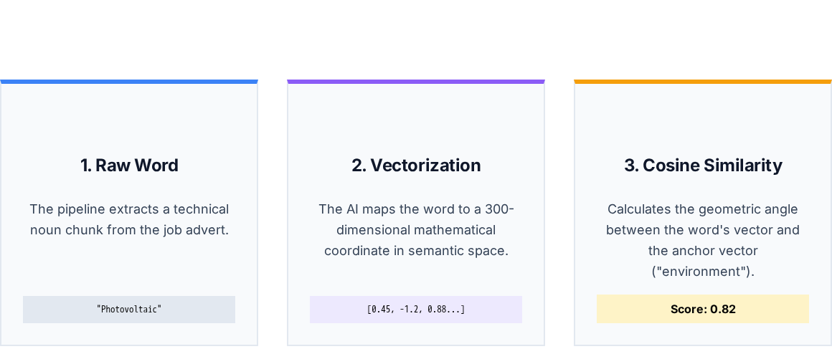
The AI Engine: How en_core_web_lg Works
We load SpaCy's "Large" English AI model. It was trained on millions of web articles and contains over 500,000 unique mathematical word vectors, allowing it to understand complex engineering terminology.

Slide 5
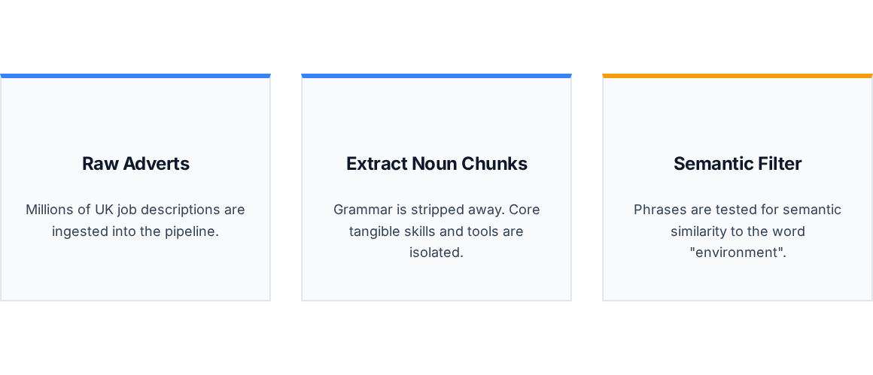
Phase 1: Process Flow

Slide 6

The Semantic Baseline
Balancing Precision and Recall
0.35
The algorithm measures the distance between extracted words and "environment" in a multi-dimensional AI space.
PASS (> 0.35): Functional terms like "photovoltaic cells" or "carbon footprint".
Minimum Cosine Similarity
FAIL (< 0.35): Unrelated business jargon like "office catering" or "team payroll".

Slide 7
Phase 2
Statistical Validation & Dictionary Building

Slide 8
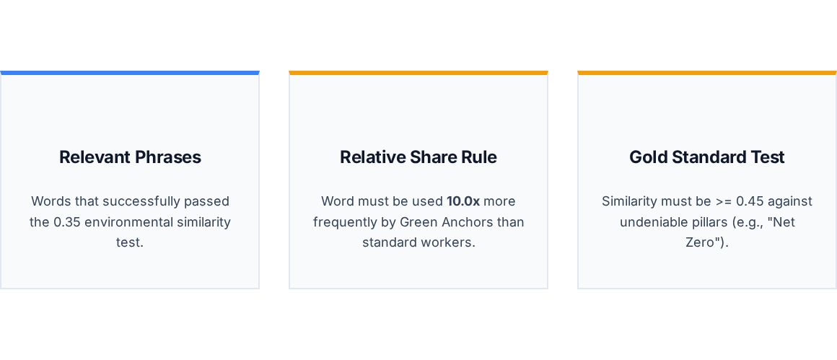
Phase 2: Validation Flow

Slide 9
Solving the Buzzword Problem
The Problem: The phrase "paper recycling" is environmentally related, but almost every office worker uses a bin. Without statistical checks, the entire UK would be classified as "Green."
The Valid Universe: We only calculate frequencies against adverts that mention at least one green term. This removes "silent" manual labor jobs from skewing the denominator.
Document Frequency: To eliminate one-off typos or repetitive recruiters, a word must appear in a minimum of 500 distinct job advertisements to be considered real.

Slide 10
Phase 3
Economy-Wide Classification

Slide 11
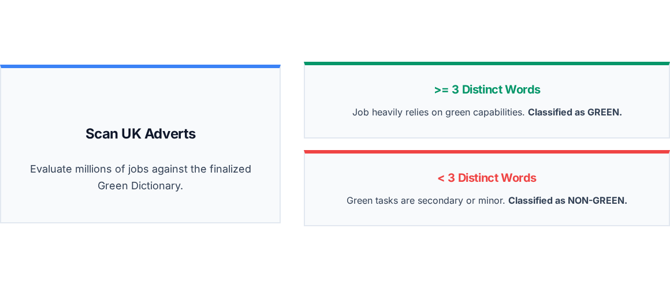
Phase 3: Classification Logic

Slide 12
Final Output: Job-Level Export
The pipeline automatically generates a highly granular, deduplicated export file for researchers to analyze specific occupational impacts.
Job ID | Year | SOC Code | Dictionary Hits | Classification
BGT-10928475 | 2023 | 3541 (Procurement Mgr) | 4 Unique Terms | GREEN
BGT-22839401 | 2023 | 2142 (Environment Prof) | 12 Unique Terms | GREEN
BGT-55910293 | 2024 | 8133 (Warehouse Sup) | 1 Unique Term | Non-Green
BGT-88492011 | 2024 | 2129 (Engineering Prof) | 5 Unique Terms | GREEN

